Slide 1


Data Analytics Bootcamp Case Western Reserve University Final Project Presentation
Raksha Karthikeyan
Alexander Melamed
Erickson Vo
Stephanie Garrett

Slide 2
Research Topic

Slide 3

Research Data

Slide 4
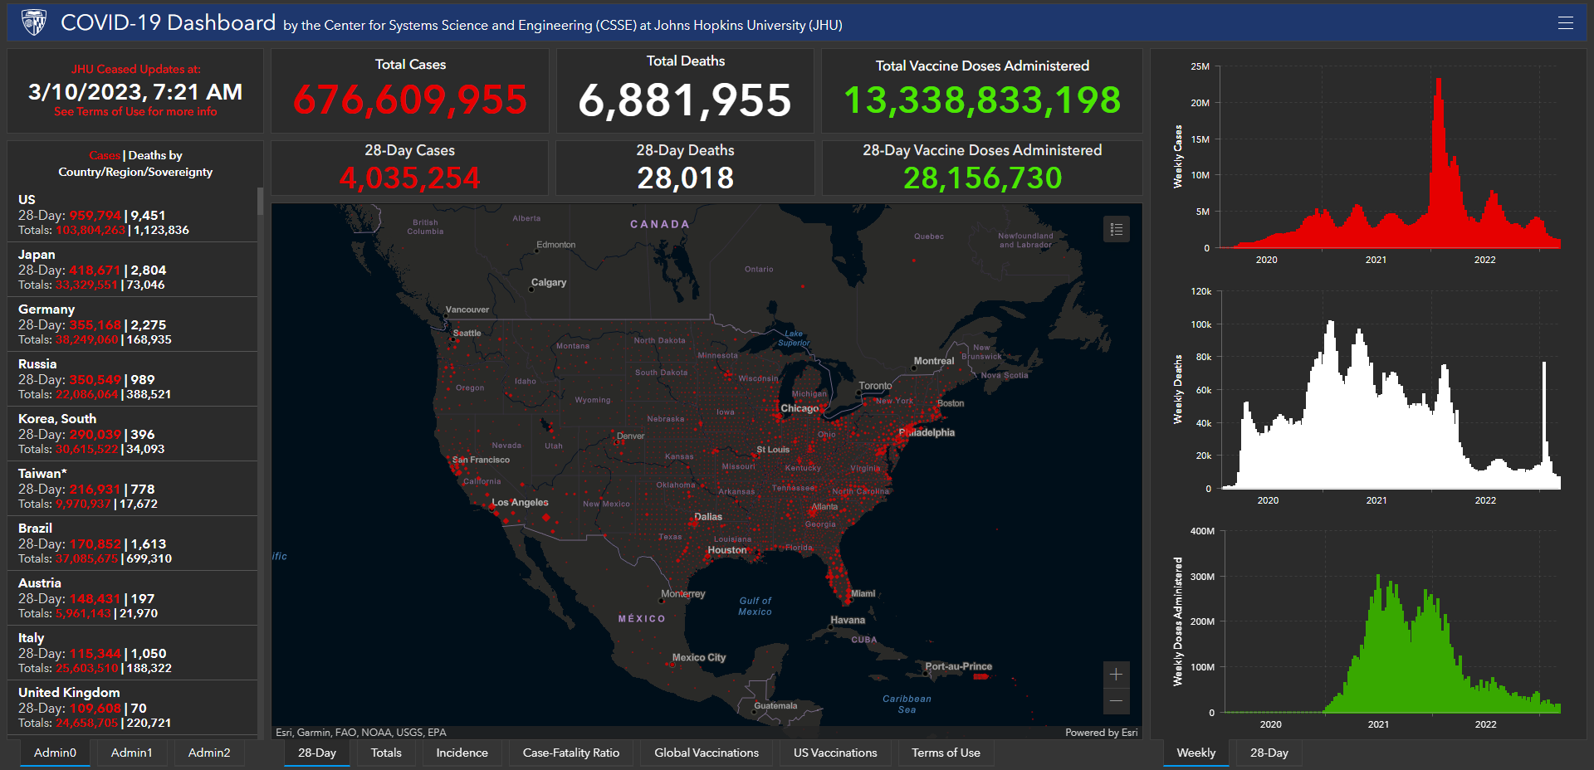
Johns Hopkins Center for Systems Science and Engineering (CSSE)

Slide 5
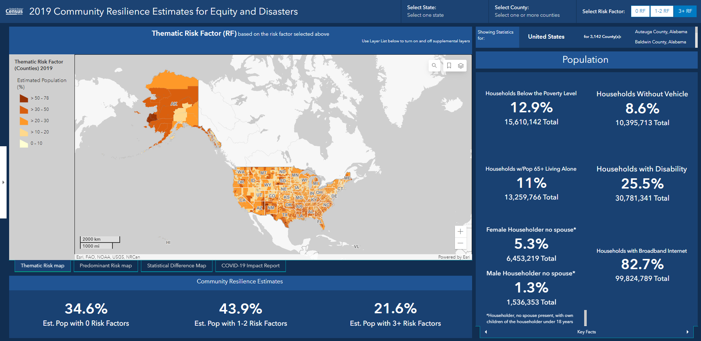
U.S. Census Bureau Community Resilience Estimates (CRE)

Slide 6
Research Questions

Slide 7
Data Exploration

Slide 8
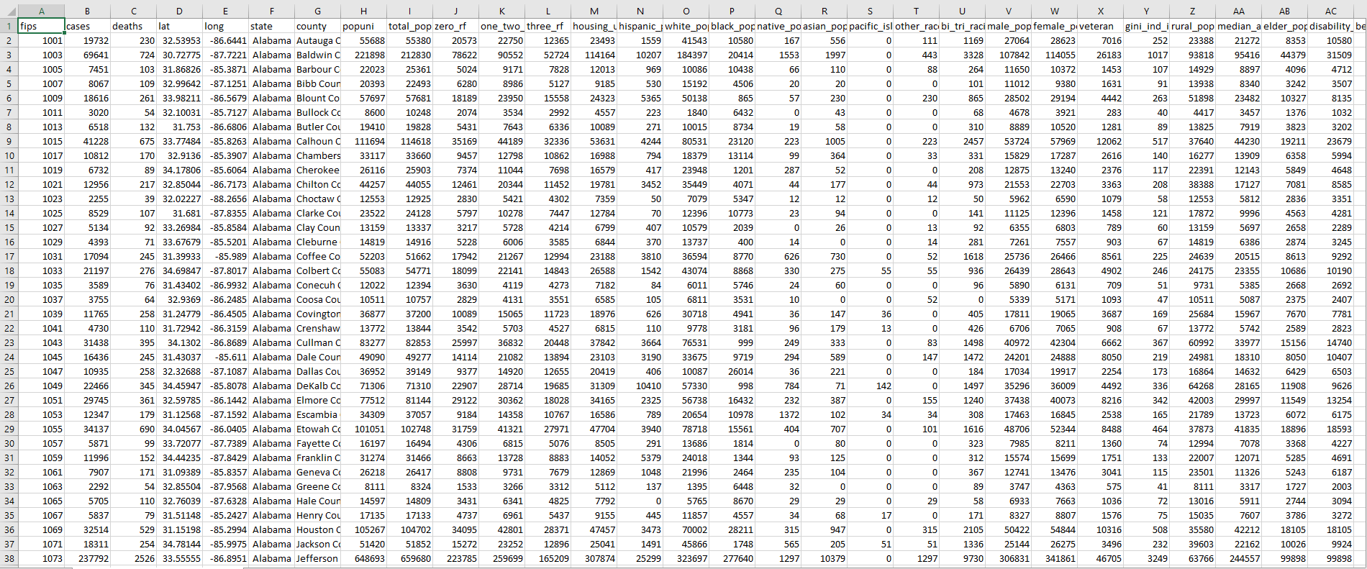
COMBINED DATASET

Slide 9
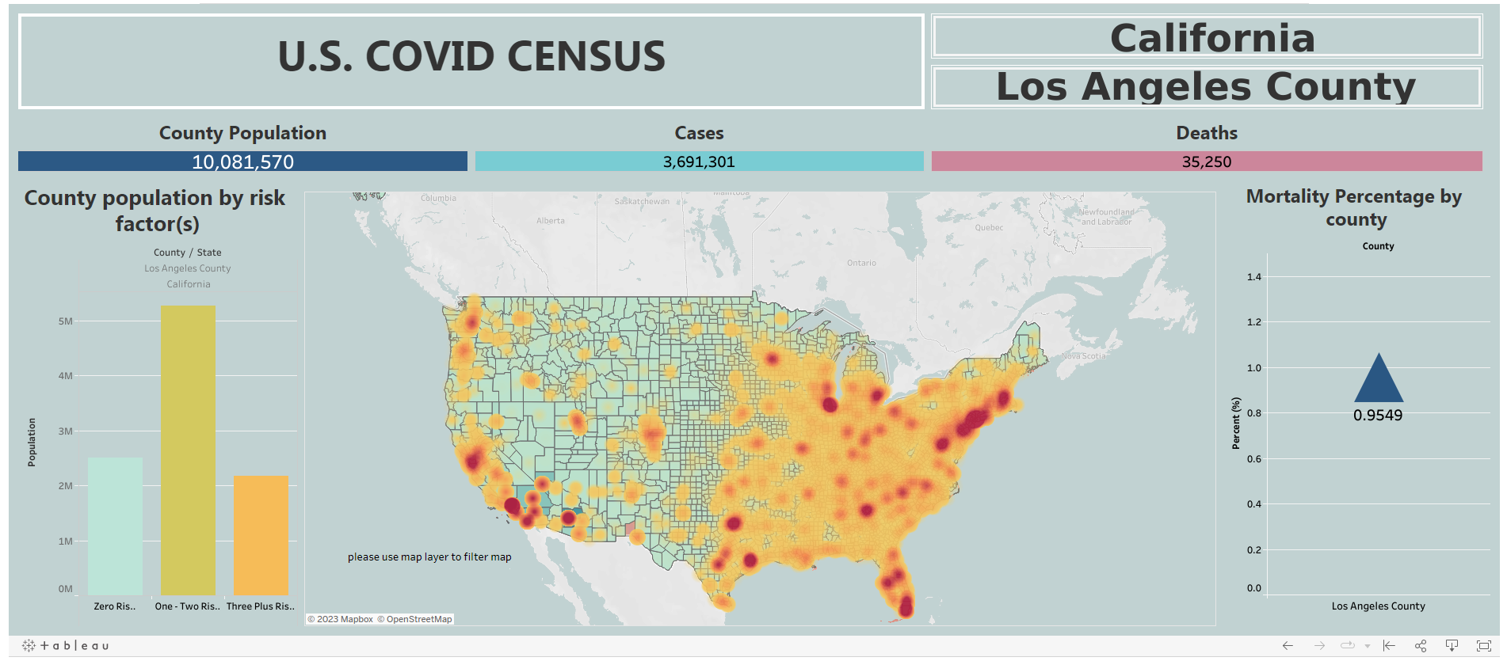
https://public.tableau.com/app/profile/erickson.vo/viz/Filterd_map_updated/Dashboard1?publish=yes
Interactive U.S. County Map

Slide 10
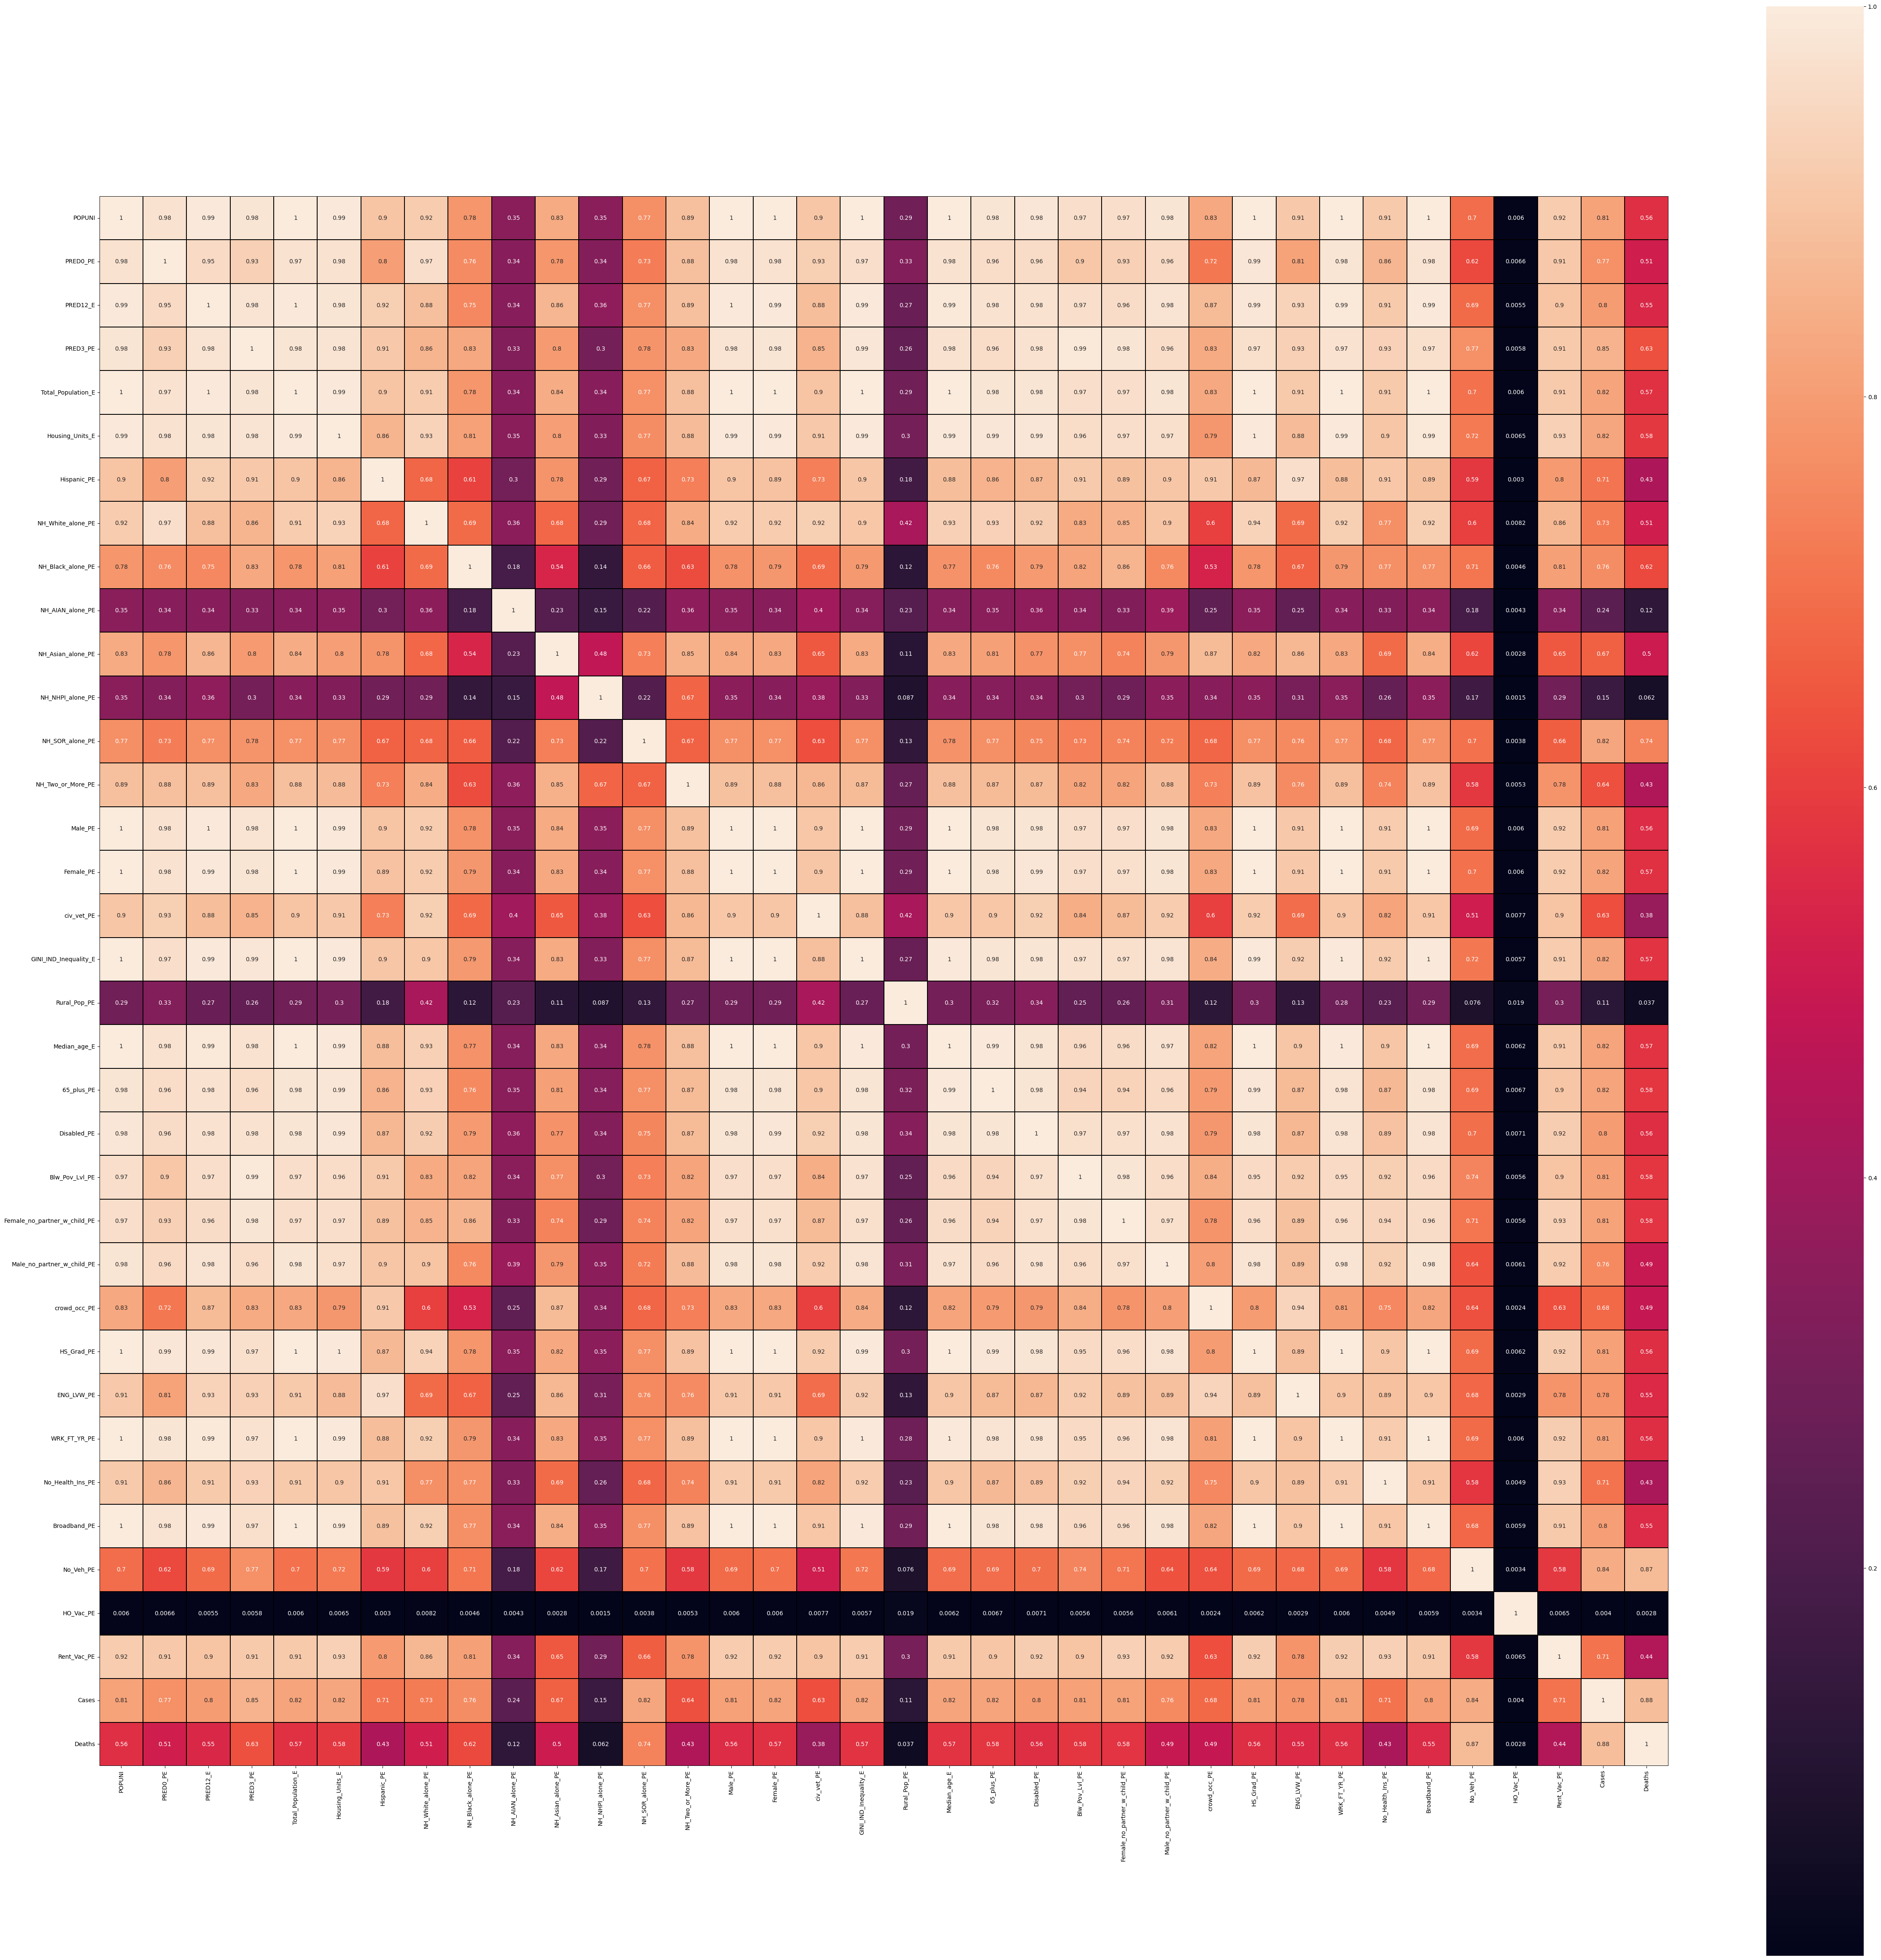
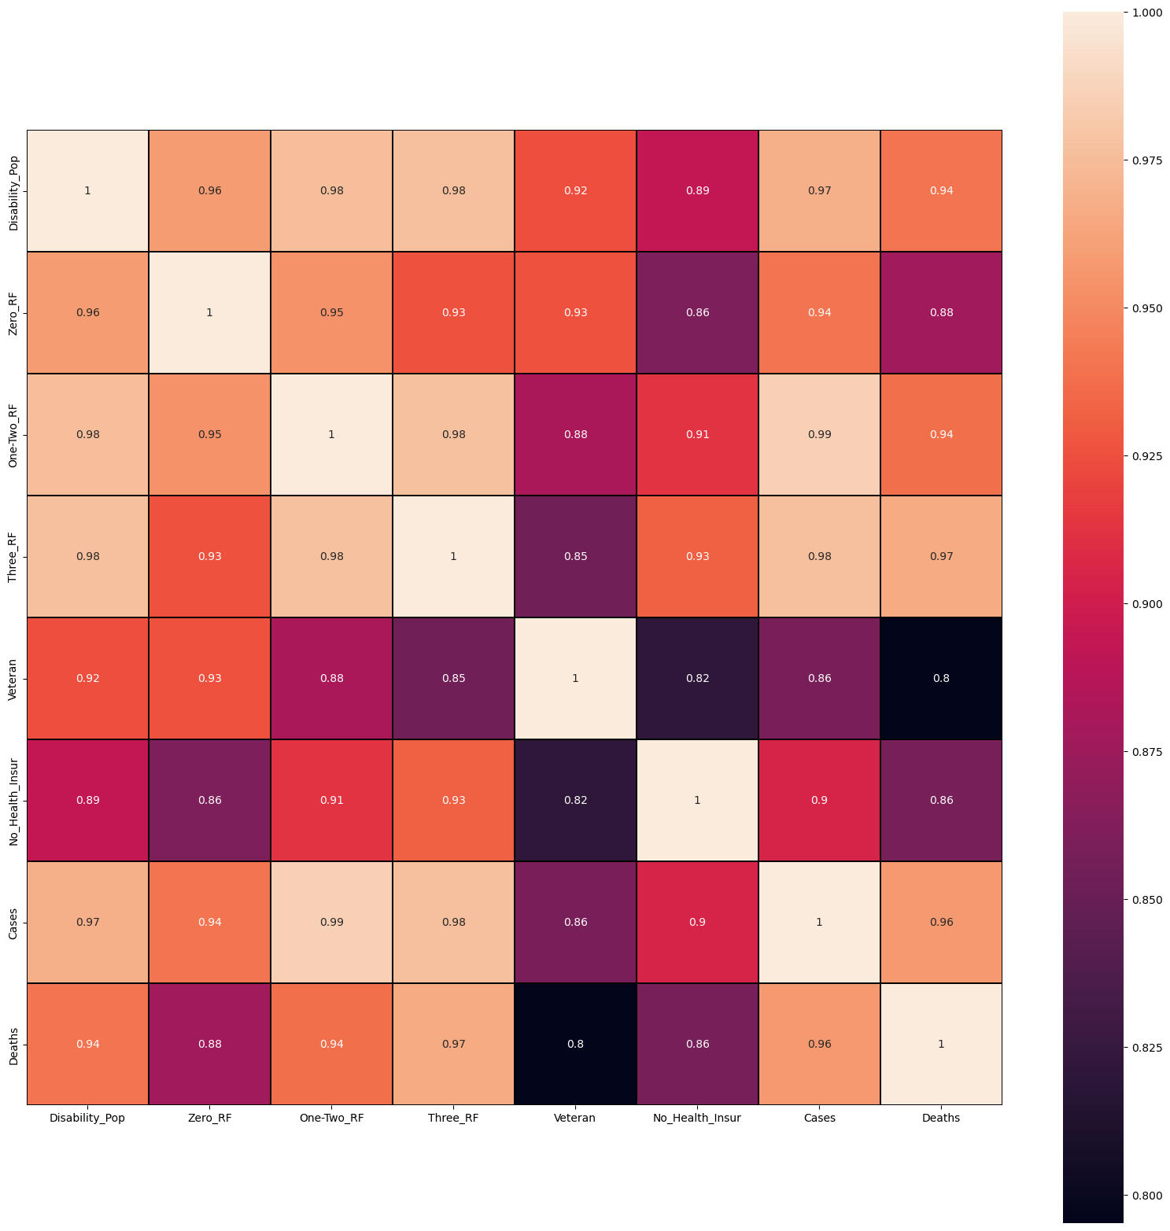
CRE VARIABLES HEATMAP

Slide 11
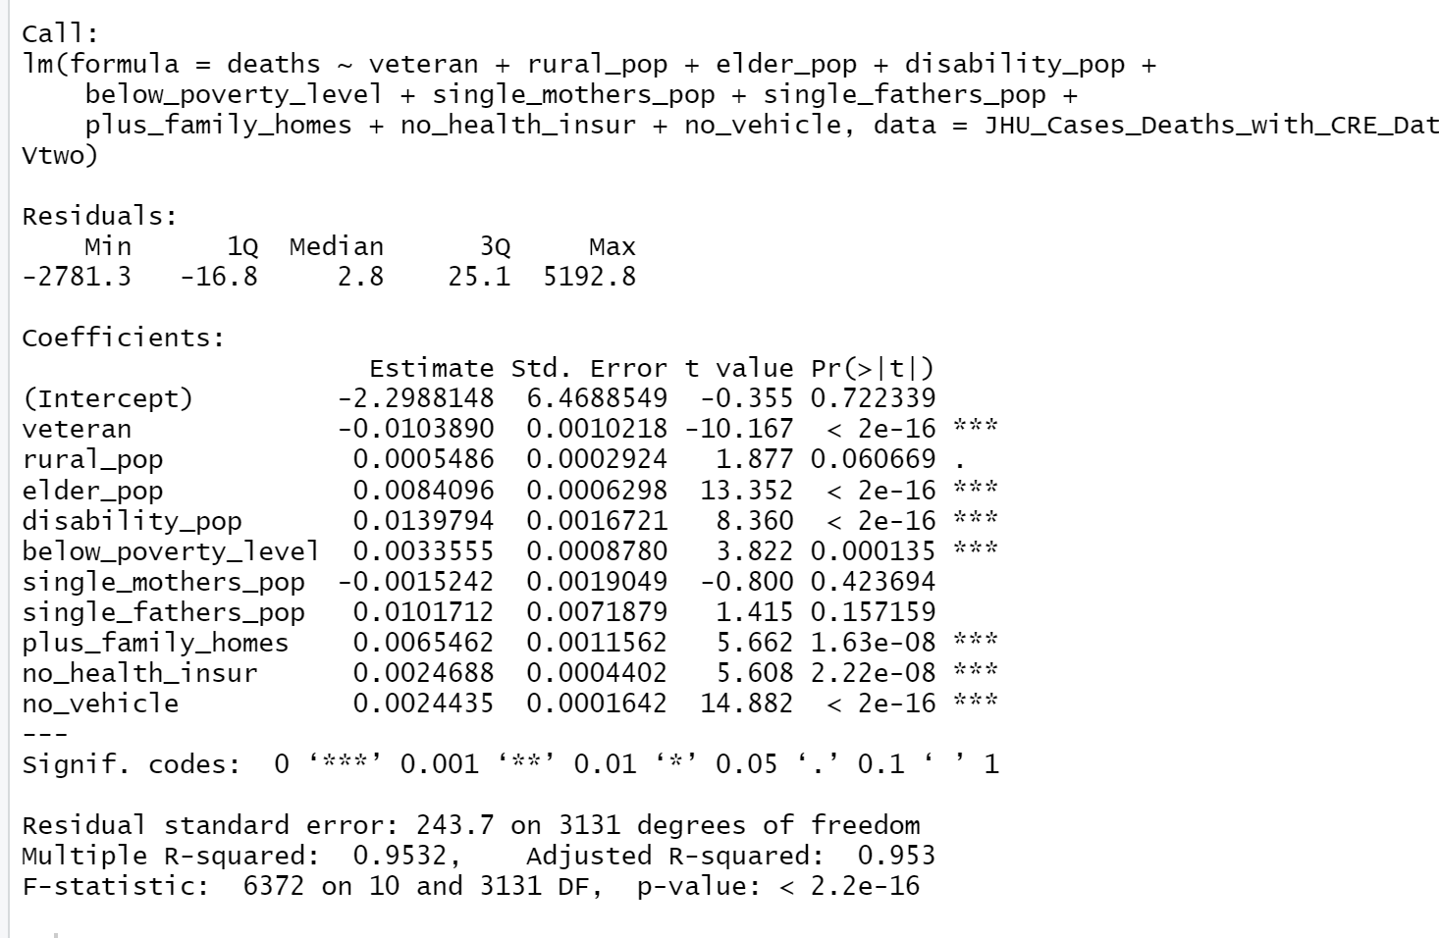
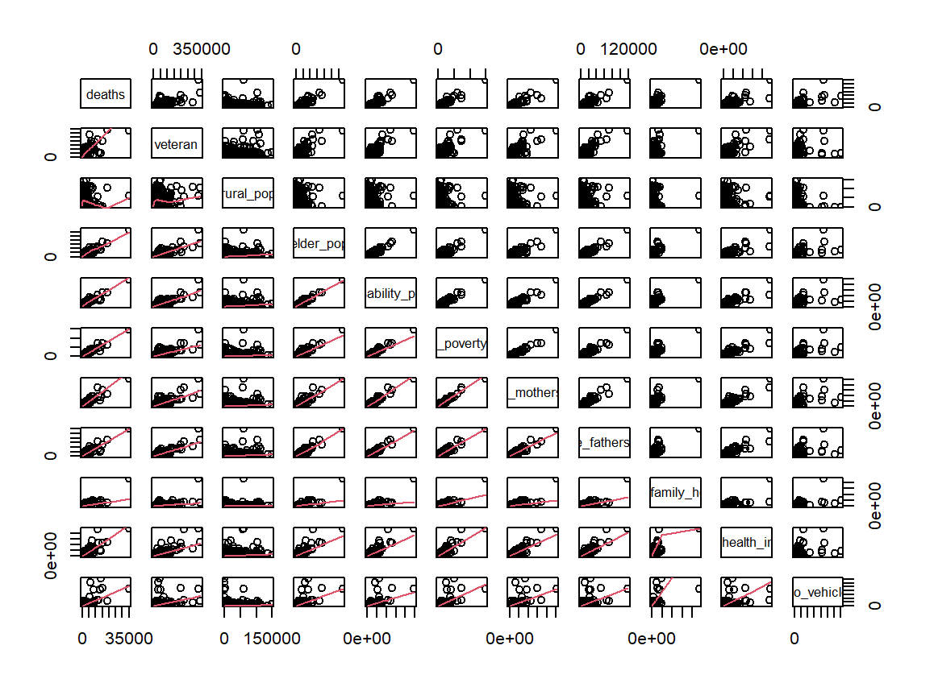
Vulnerable Populations

Slide 12
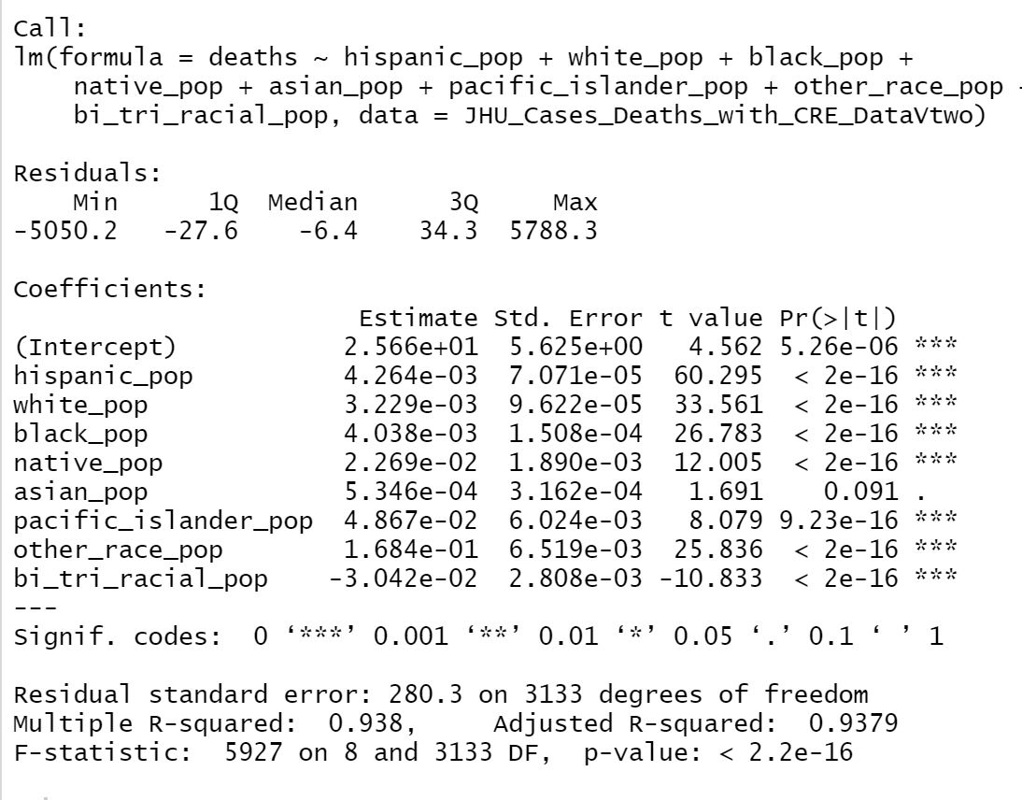
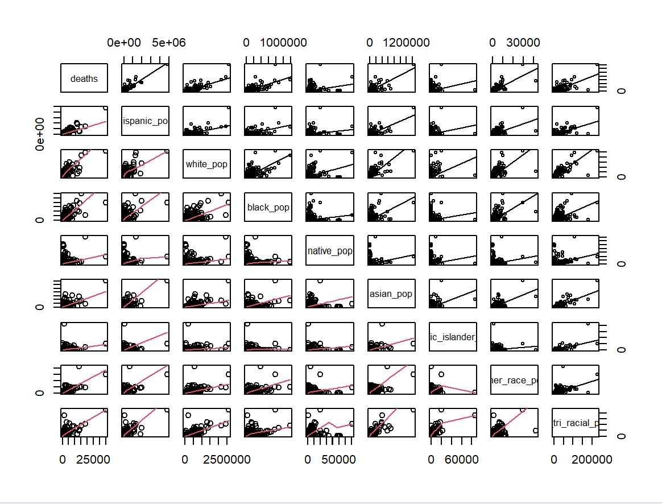
Racialized Populations

Slide 13
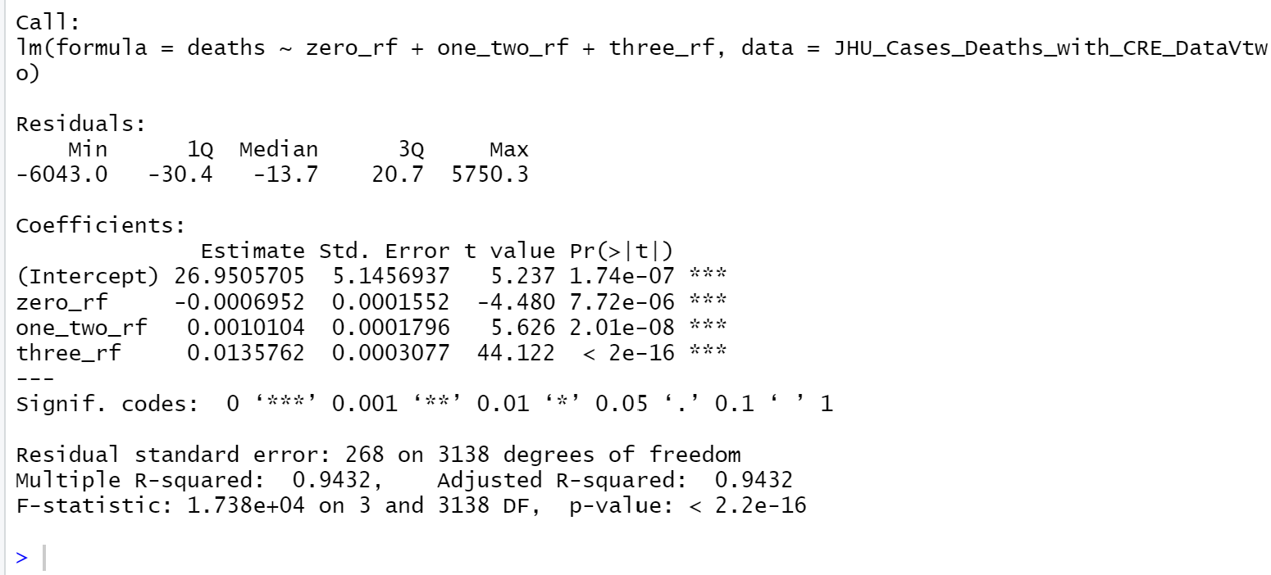
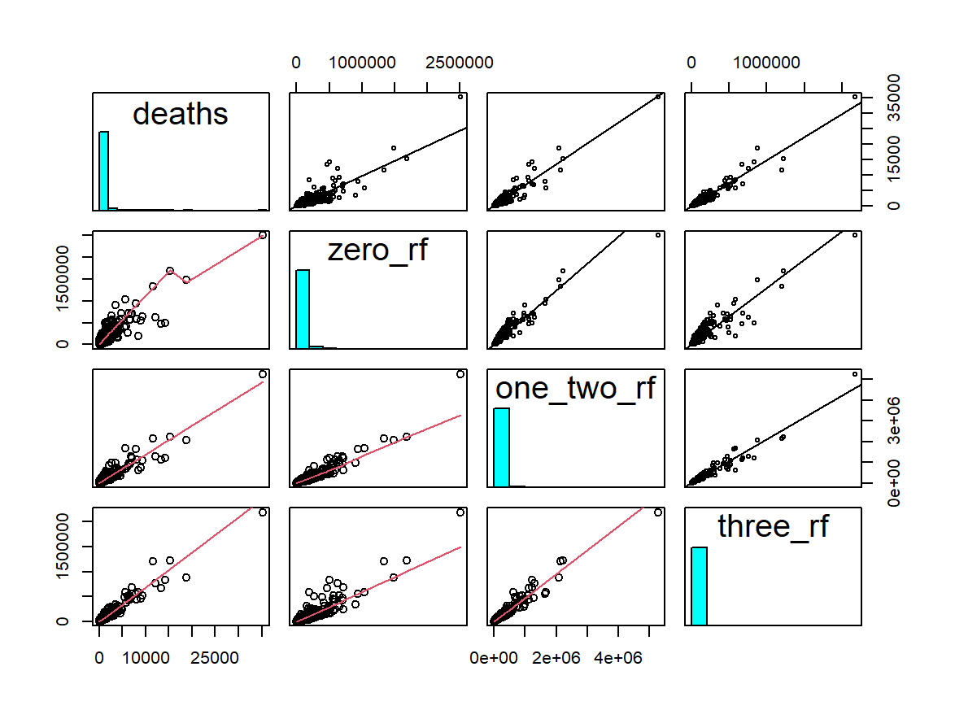
Combined Risk Factors

Slide 14
Data Analysis

Slide 15
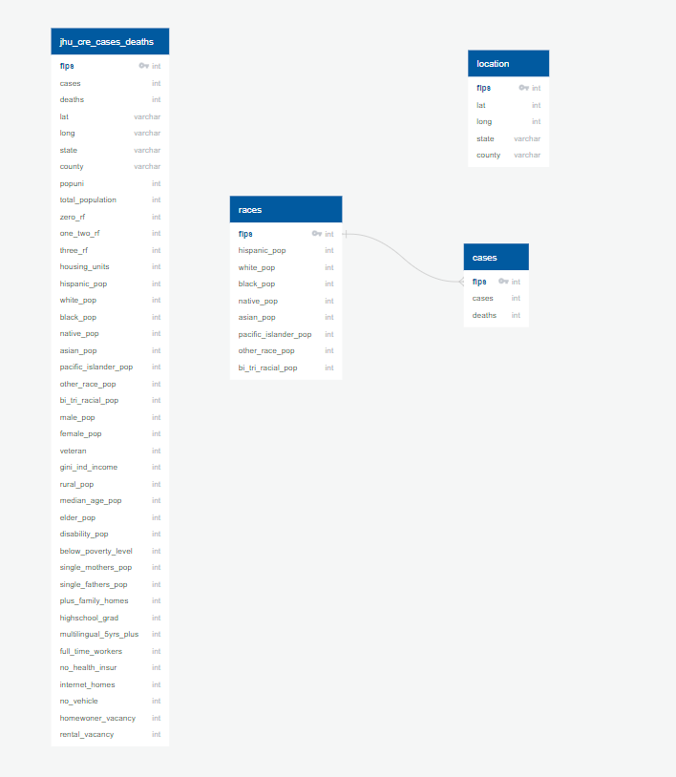
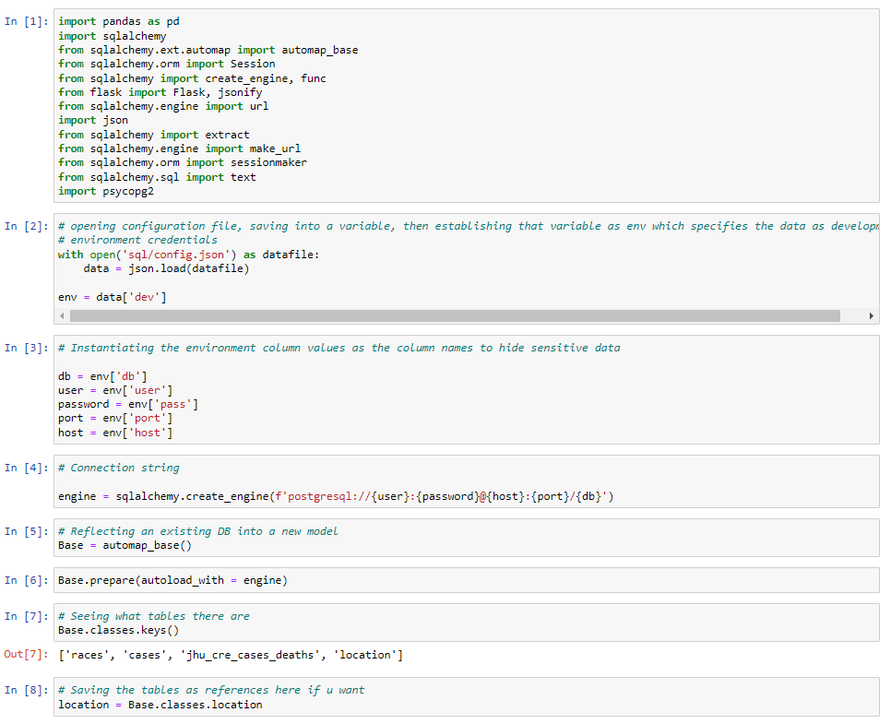
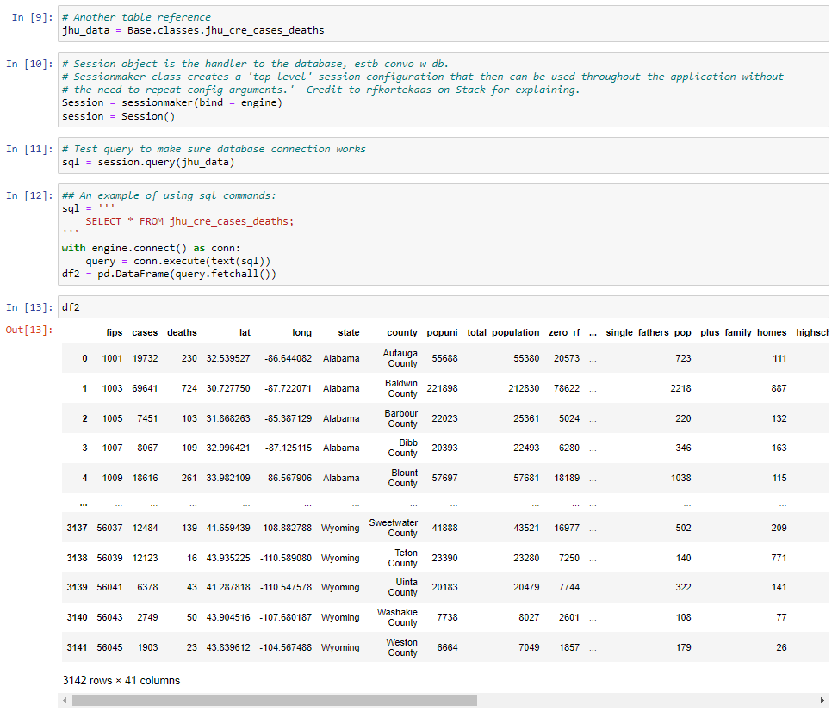
SQL
PYTHON

Slide 16
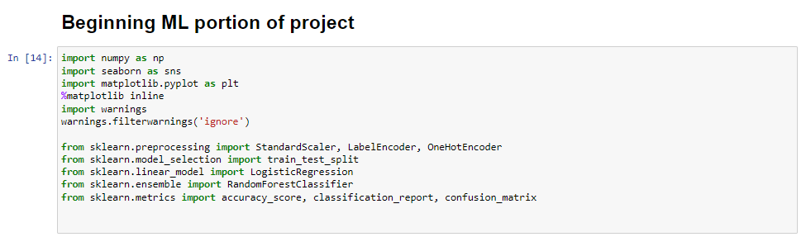
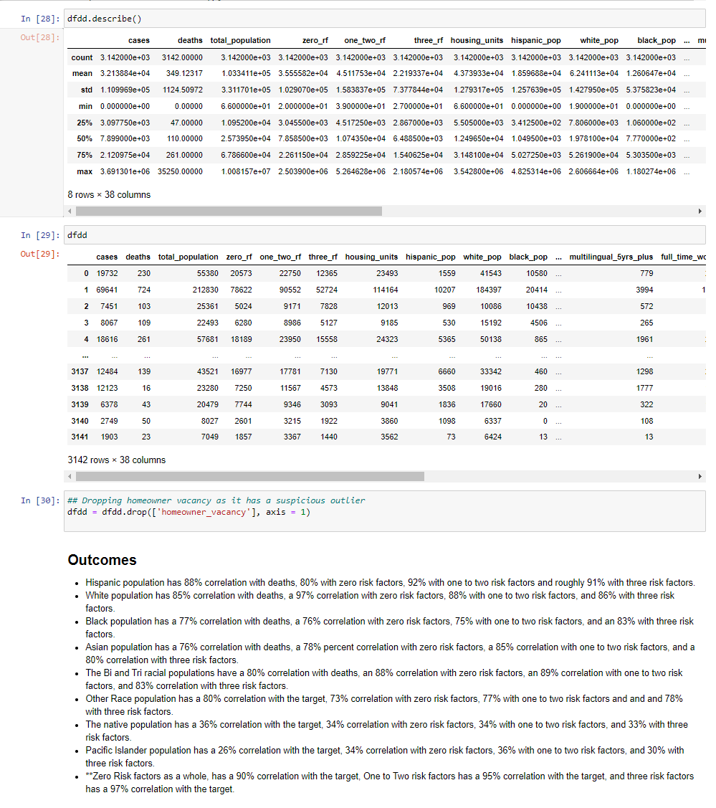
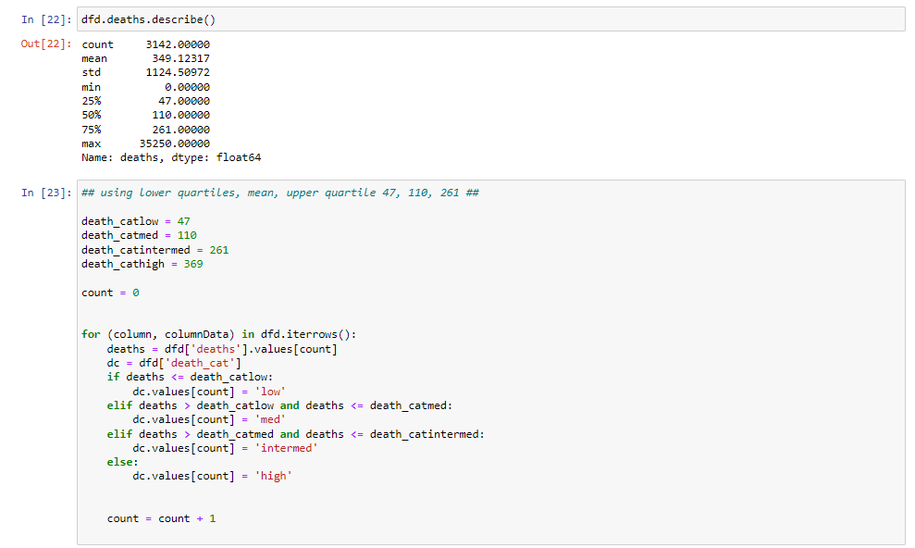
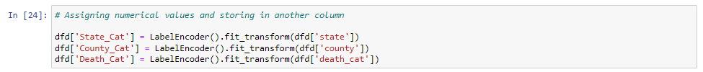

Slide 17
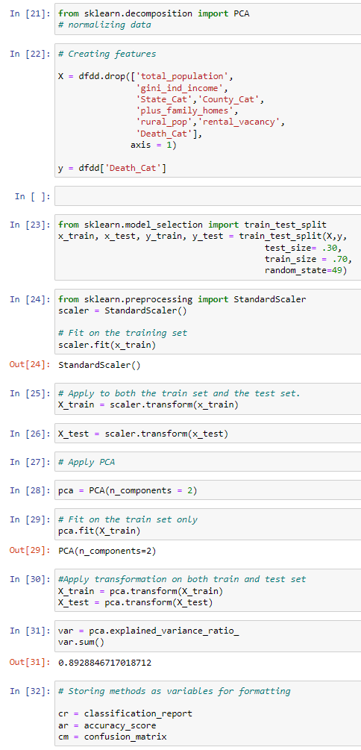
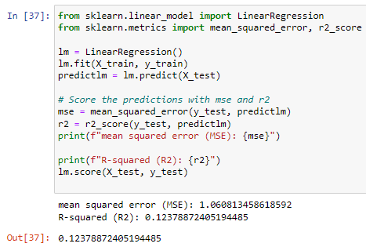
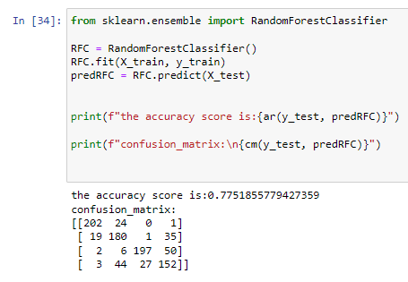
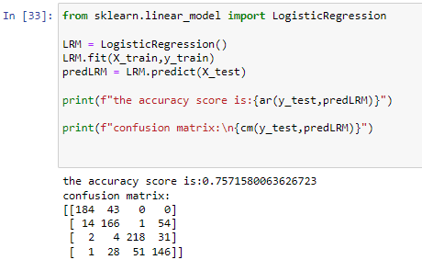
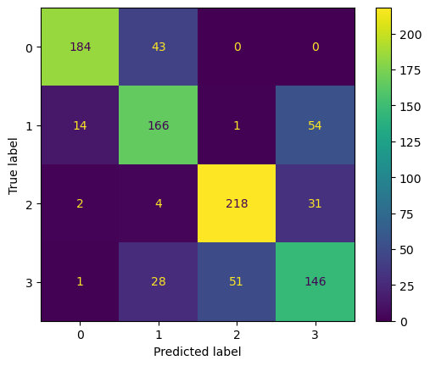
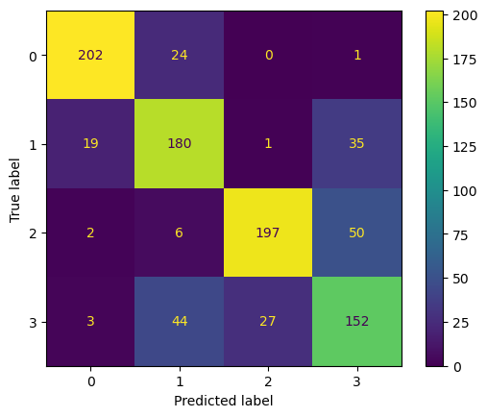
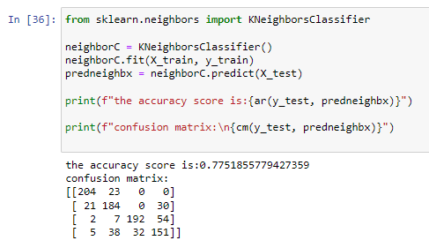
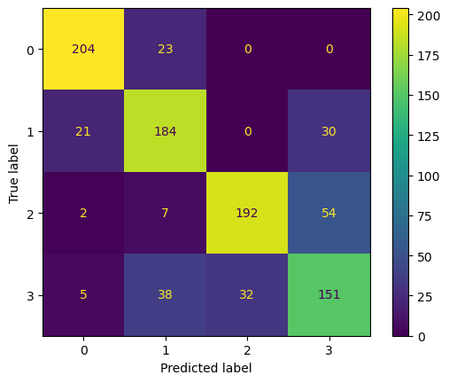
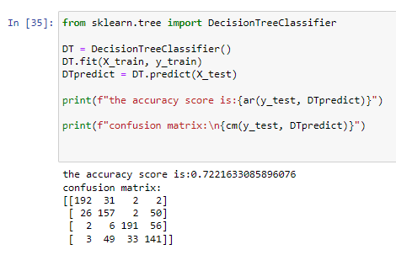
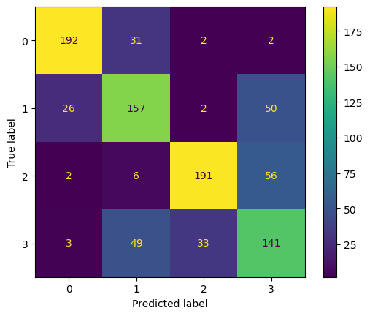
Classifier Models

Slide 18
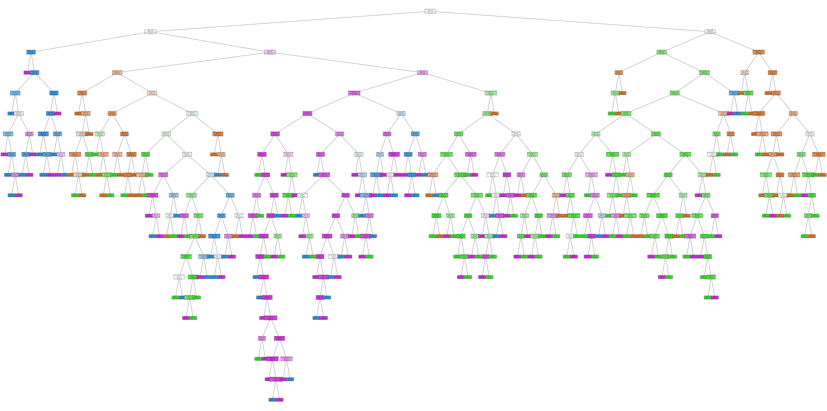
Decision Tree for Random Forest Classifier Model

Slide 19
RESULTS
&
CONCLUSIONS

Slide 20
FINAL
REMARKS

Slide 21
QUESTIONS
&
ANSWERS

Slide 22
THANK
YOU!

